Slide 2
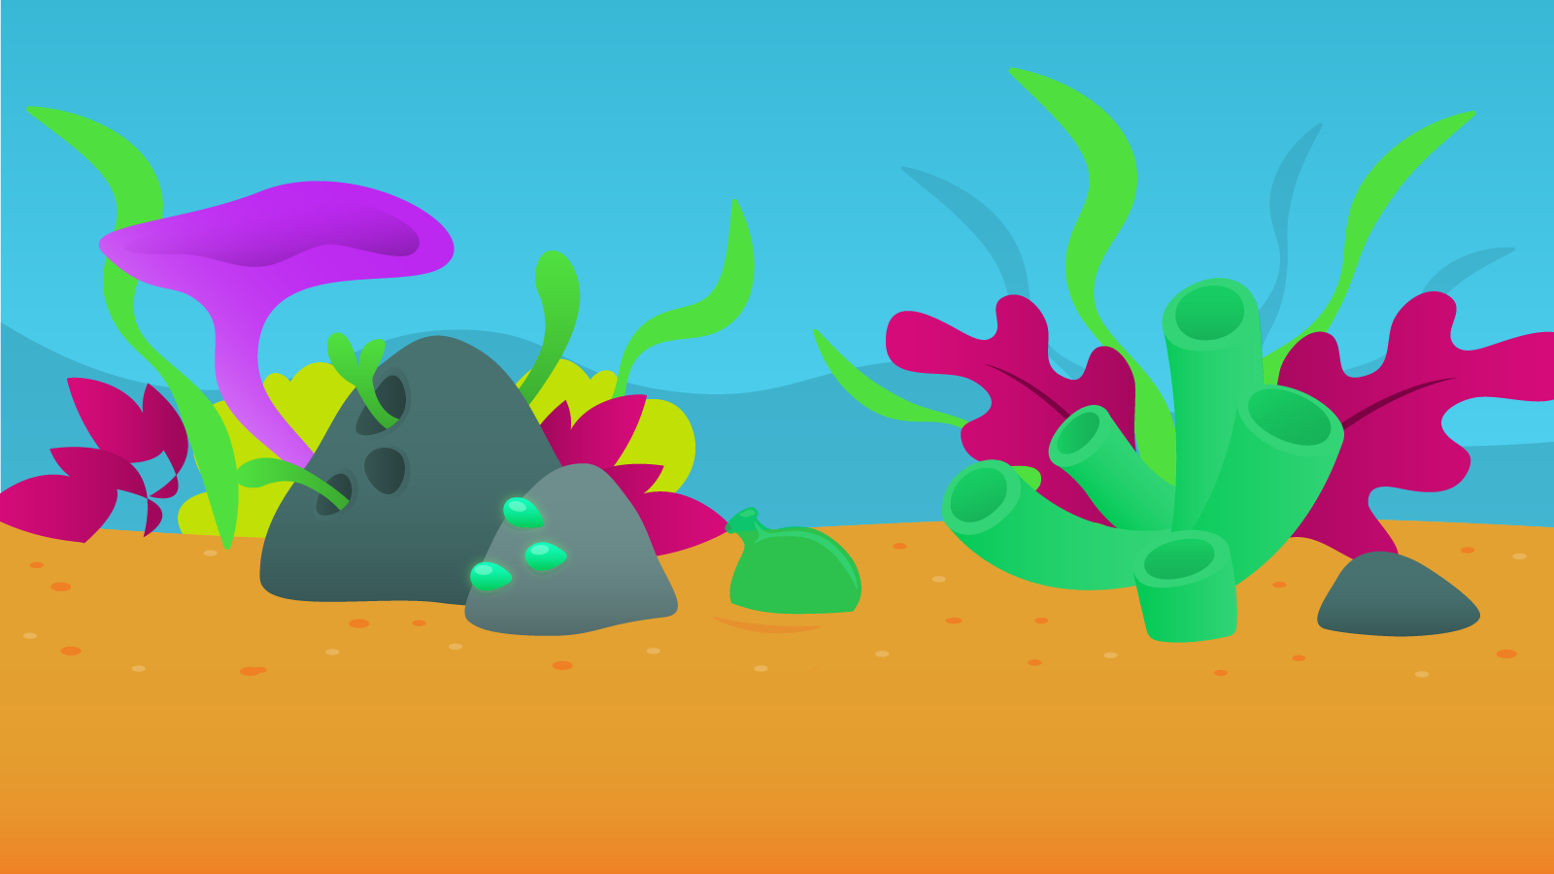
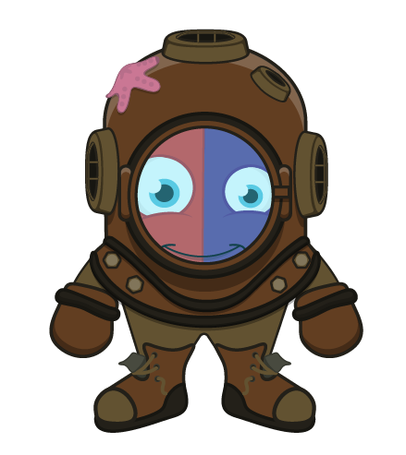
Student Resource
App or Online version.
The App is free to download
The App works on Windows, Chromebooks, Android phones, iPads and iPhones.
.

Slide 3
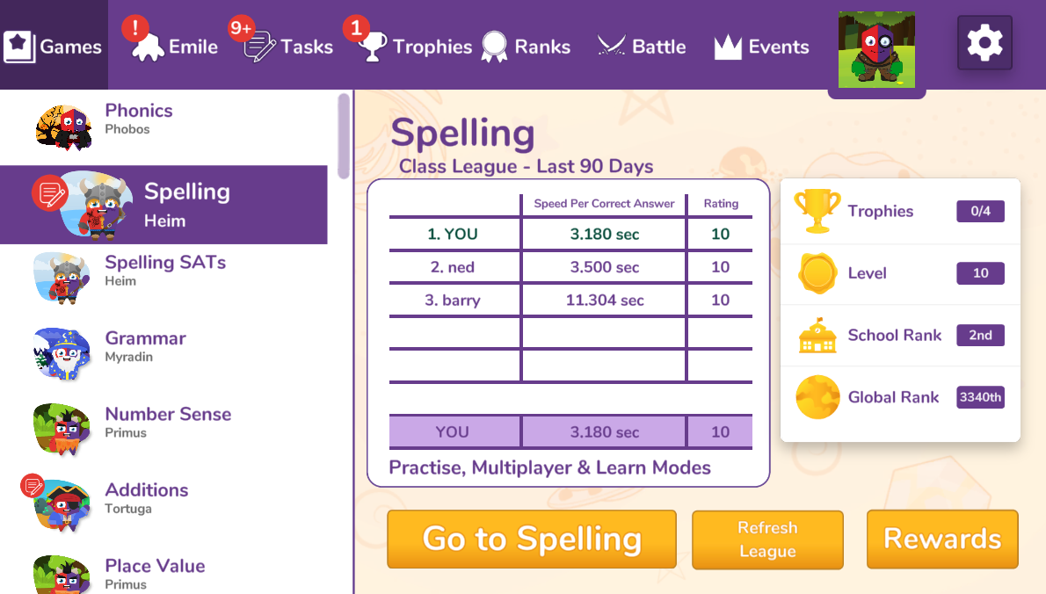
Student Resource – Hub Screen
Student’s own tamagotchi
Work set by Teachers
Competition within a Class
Competitions between Classes or Schools
Different Strands Covered

Slide 4
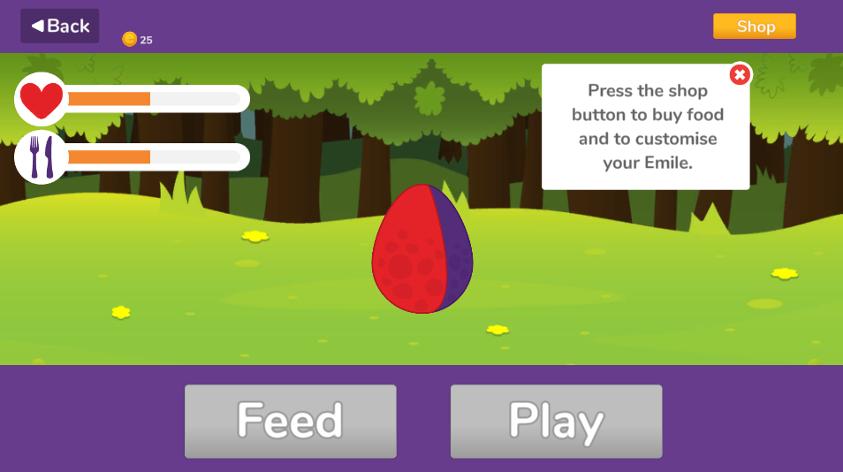
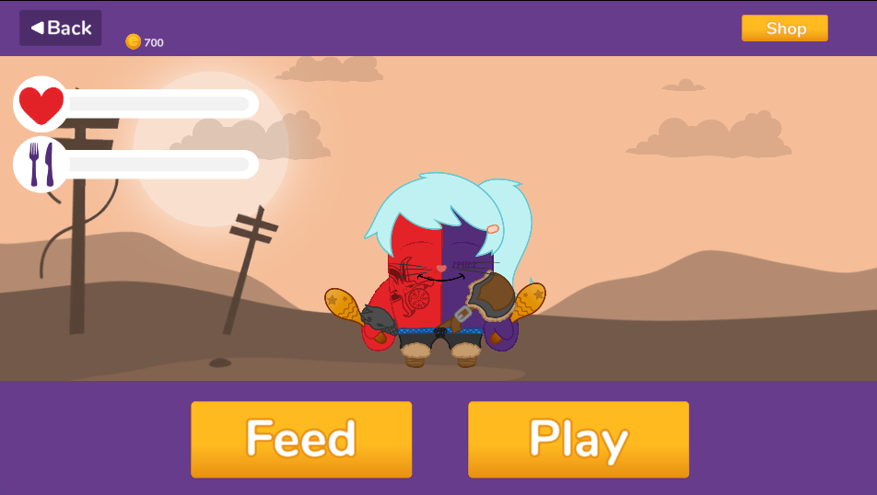
Student Resource – Tamagotchi
In the App, all students get their own Tamagotchi who grows from an egg to a baby to a toddler to a teenager to an adult (usually within 7 days).
Students use coins earned in games to buy outfits, backgrounds, games ,…., for their Tamagotchi.

Slide 5
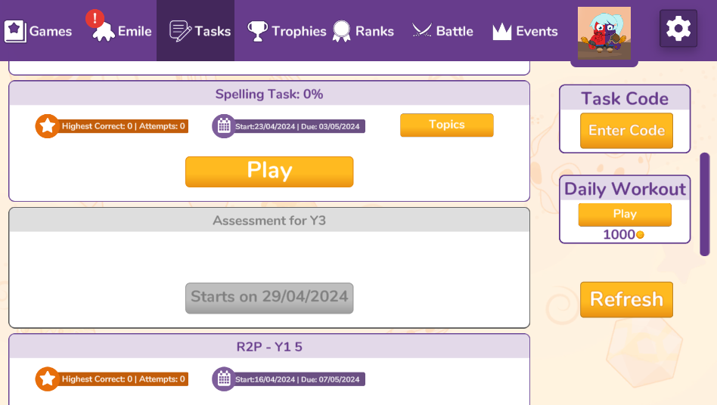
Student Resource – Tasks
Task Codes are listed on our website, in our planning documents and in our powerpoints. They allow teachers to set work without logging in to the Teacher Portal.
Work set by teachers, will appear under Tasks.
Students can also enter a Task Codes on this screen.
Tasks that start in the future are greyed out until the start date.

Slide 6
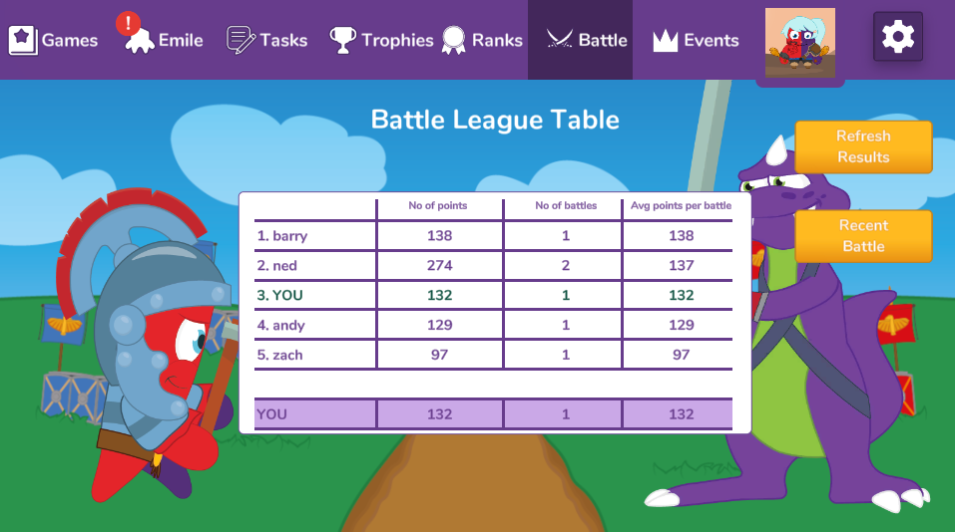
Student Resource – Battles
Battles are competitions within a class.
Teachers set a time period and any student in that class has to play a set game once. It builds up a league table over the school year.
They are commonly used like a quick fun assessment to confirm students know recently taught topics.

Slide 7
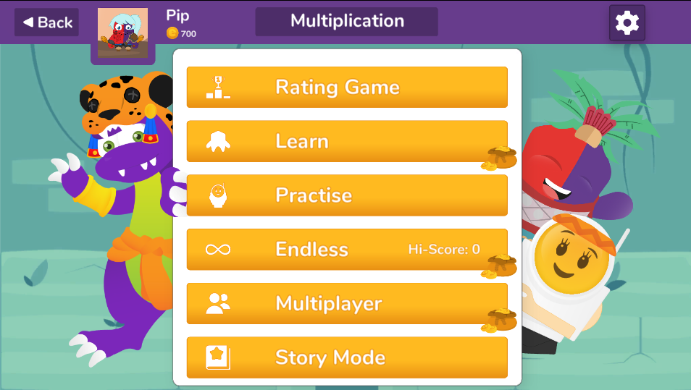
Student Resource - Strands
Rating Game:
Baseline assessment to help Emile adapt to the student.
Most strands are structured like shown below.
The Learn Games in particular have been shown to have a big impact on recall and fluency.
Learn Game:
Multiple round game with scaffolded learning in the first few rounds.
Practise Game:
Allows students to test themselves at an appropriate difficulty level.
Endless Game:
Game with no competition and no time aspect.
Multiplayer Game:
Allows students to play against classmates.
Story Mode:
Fun games to improve fluency.

Slide 8
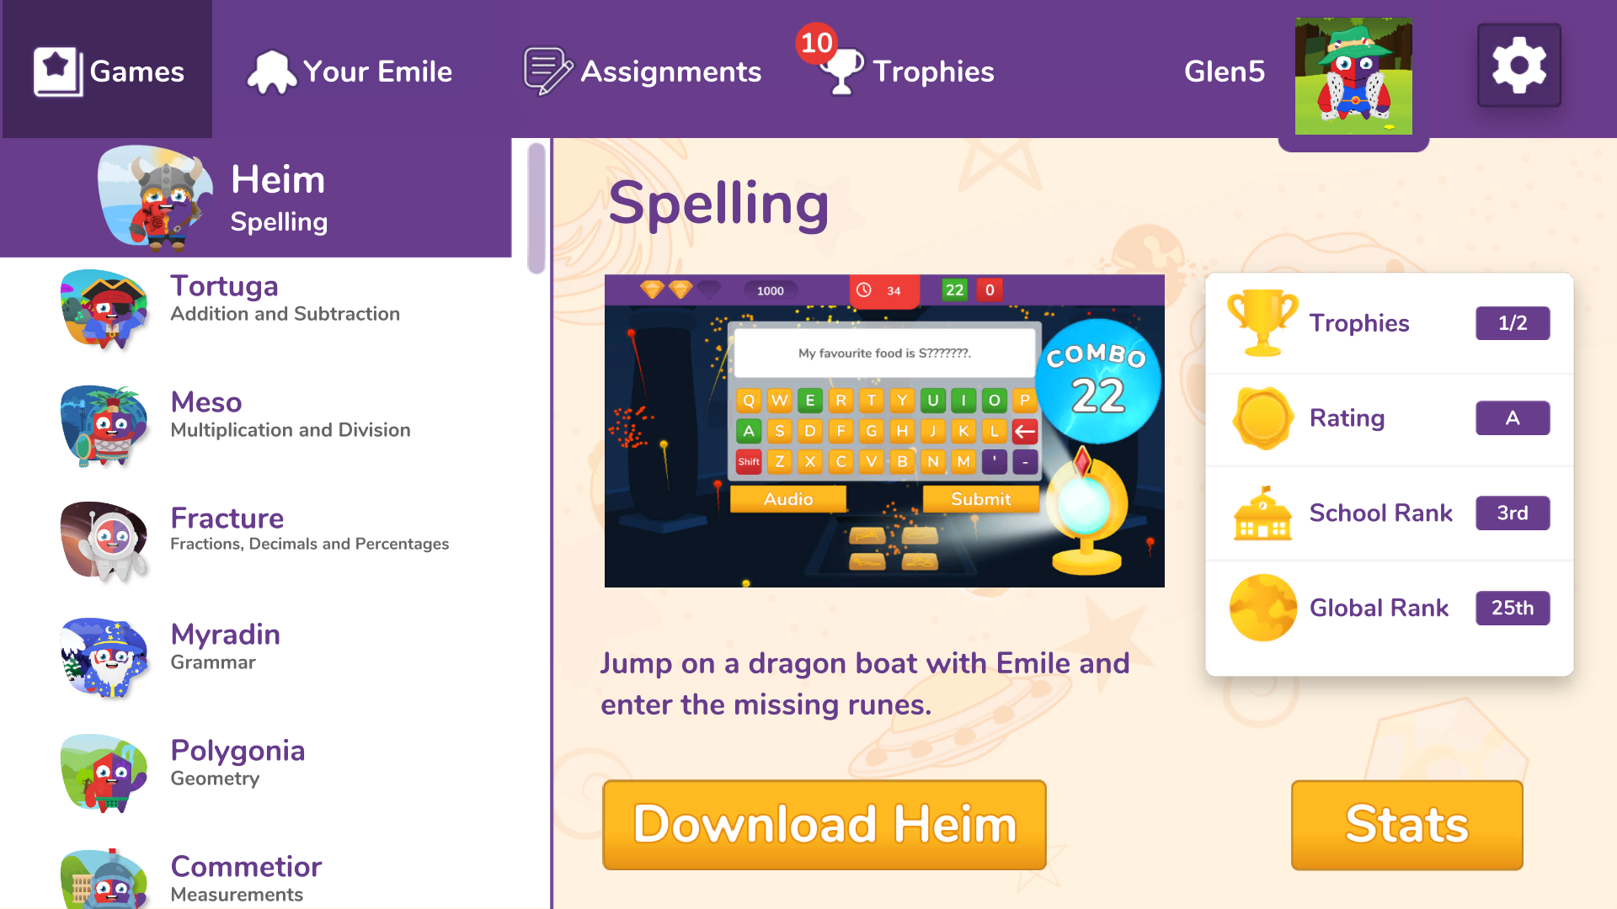
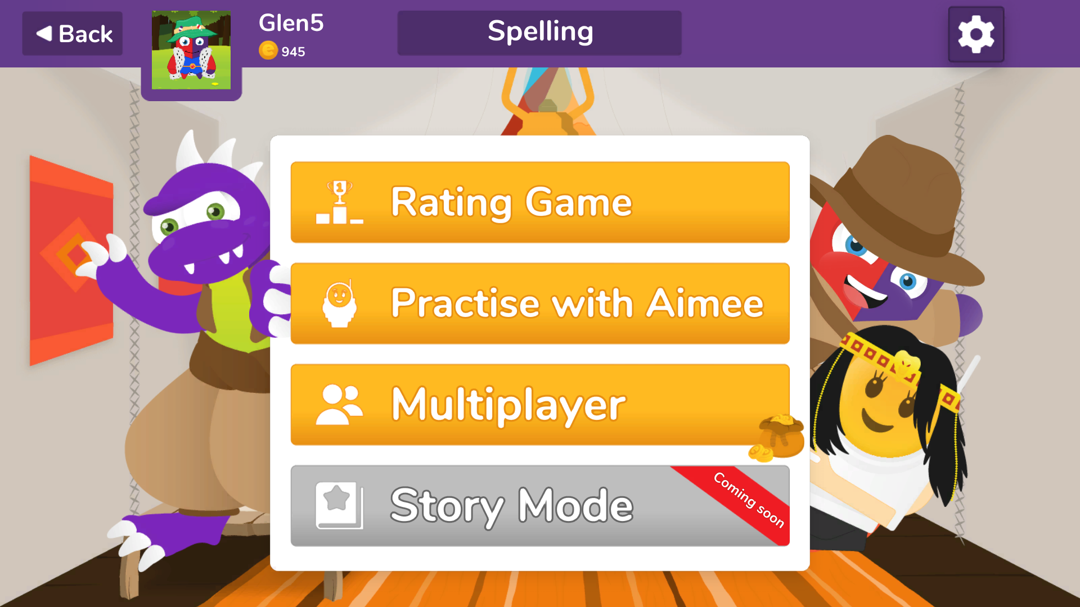
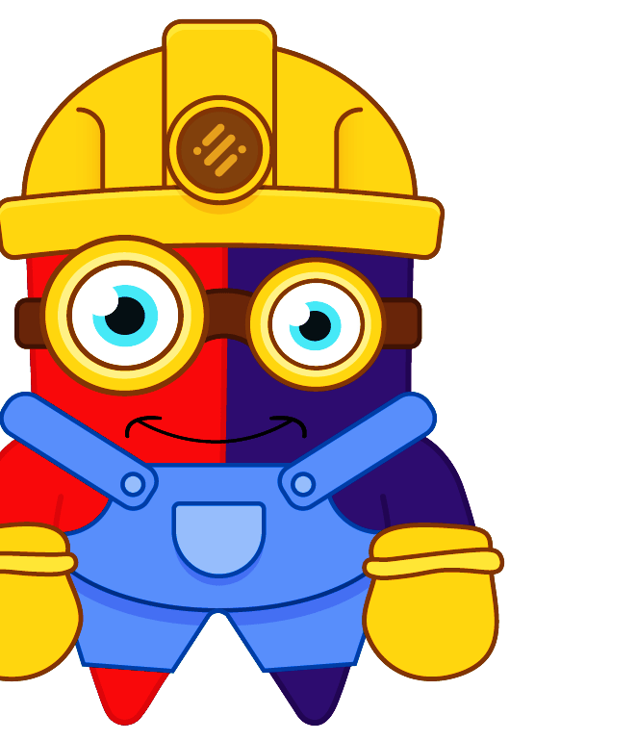
Student Resource
When a student logs in they can choose a ‘strand’ such as Spelling or Times Tables.
In each strand a student must first play a ‘Rating Game’.

Slide 9
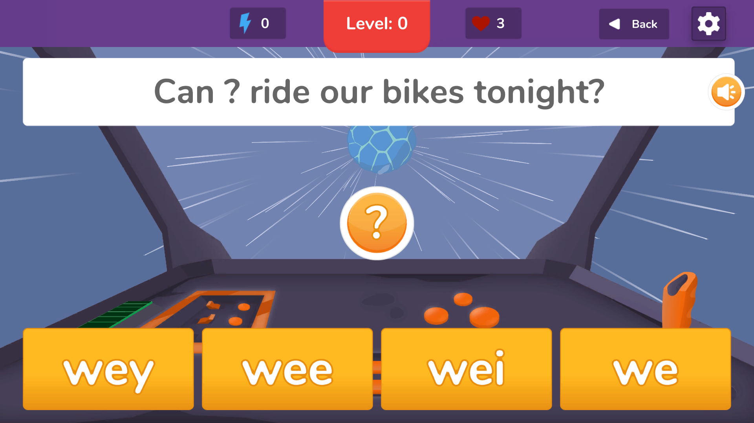
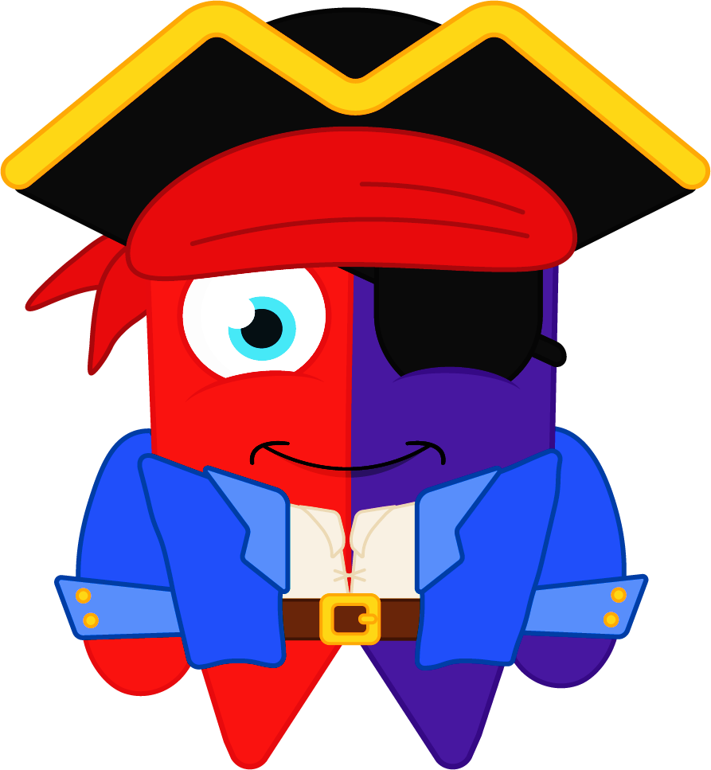
Student Resource
The Rating Game is a simple multiple choice game that starts at a low level and advances through the national curriculum content. In this way, system gets a base line of the student’s ability in that strand.
If a student starts getting everything right (or wrong), they are made to do another rating game.

Slide 10
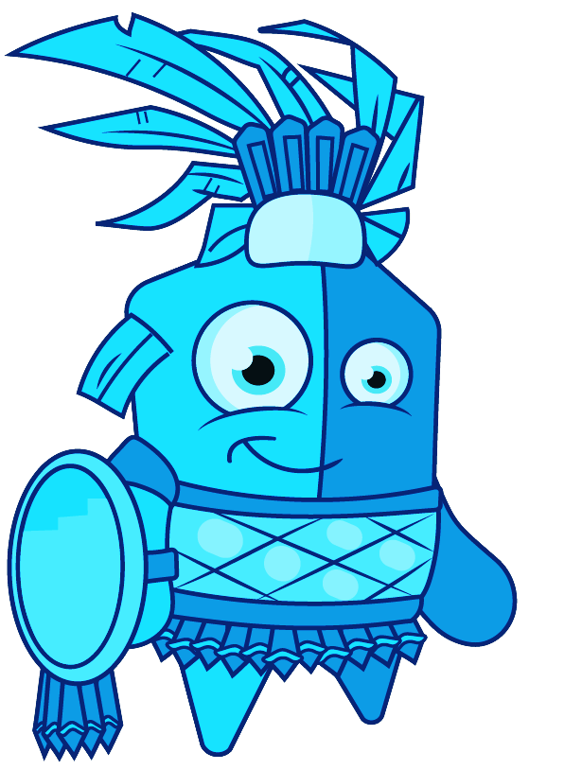
Student Resource
Student Resource Once a student has a level in that strand, they are free to:
Practise on their own
Play multiplayer games against classmates
Play multiplayer games against students all over the world. Or
Play story mode (if using the app version).
They are limited to games and activities appropriate to their rating in that strand.
The multiplayer games between classmates where students are at different levels is done at the lowest level of the students. So if students at 3,6,7,8 & 9 play against each other, then the questions will be from level 3.

Slide 11
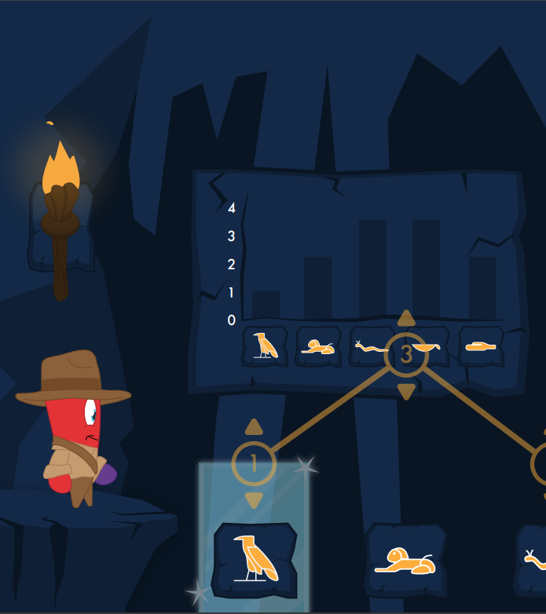
Support
If you would like further support from the school staff then please contact us at office@homefield-primary.co.uk.
If you are looking for a particular feature, have a question or need support, please get in touch and we would be delighted to help.
Hello@Emile-Education.com

